Slide 1

Traffic ACCIDENT SEVERITY PREDICTION
Applied Data Science Capstone Project

Slide 2
Introduction
Traffic Accidents are:
Cause of 1.35 million deaths globally.
Predicted to become the 7th leading cause of death by 2030.
Prediction of Accident Severity will be beneficial to multiple stakeholders included below:
Public Development Authority of Seattle (PDAS)
Citizens
Insurance / Healthcare Agency

Slide 3
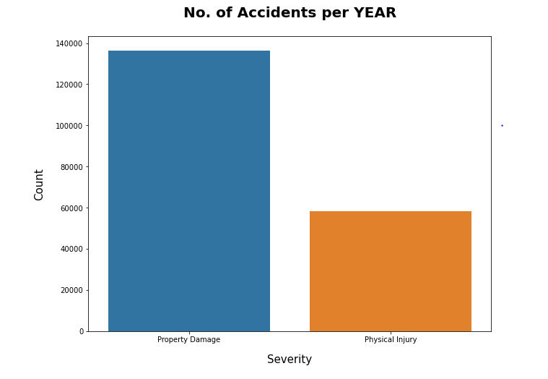
Target Variable
The target variable feature a binary classifier
Property Damage
Physical Injury
The dataset is not balanced well as can be seen
from the figure on the right.

Slide 4
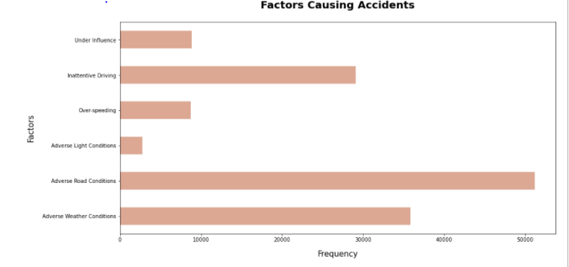
Factors causing accidents
Ranking (Highest to Lowest)
Adverse Road Conditions
Adverse Weather Conditions
Inattentive Driving
Under Influence
Over-speeding
Adverse Light Condition

Slide 5
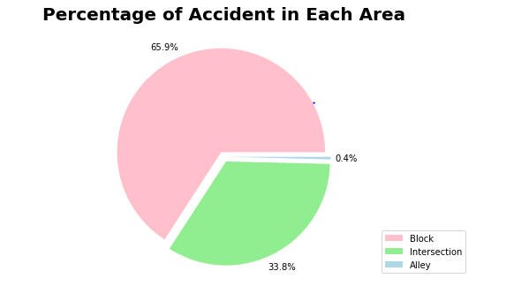
Accidents Prone Areas
Accidents are prone to happen at Block and at Intersection
More attention should be place at these place to reduces occurance

Slide 6
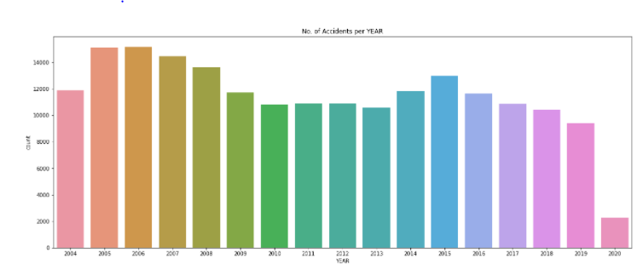
Accidents Seasonality - YEAR
Downtrend of accidents happening yearly. The number of accidents occurred peaked at 2005-2006.

Slide 7
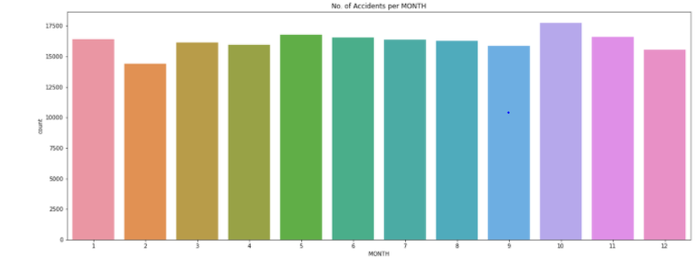
Accidents Seasonality - MONTH
Number of accidents increase from February to May, then again in September. It decreases at the end of the year.

Slide 8
Classification Models
Decision Tree
Criterion = Entropy
Max-Depth = 6
Linear Regresion
C = 0.1
k-Nearest Neighbour
K = 4

Slide 9
Results
Algorithm | Average F1-score | Property Damage (1) vs Injury (2) | Precision | Recall
Decision Tree | 0.60 | 1 | 0.72 | 0.68
 |  | 2 | 0.35 | 0.39
Logistic regression | 0.60 | 1 | 0.72 | 0.69
 |  | 2 | 0.35 | 0.39
k-Nearest Neighbour | 0.61 | 1 | 0.70 | 0.88
 |  | 2 | 0.35 | 0.15
Logistic Regression would be the best model as it shows a well-balanced recall and also a good F1-score.

Slide 10
Conclusion
Model could have performed well if few more criteria are present:
A balanced dataset for the target variable
More instances recorded for accidents taken place in Seattle, Washington
Less missing values within the dataset
More factors to be evaluated

